Slide 1
CS F213
Object Oriented Programming
Lab 2
Classes, Objects, Methods and Constructors

Slide 2
Agenda
Accepting user input
Classes and Objects
Constructors
Default Constructors
Parameterized Constructors.
Methods
Problems to be demonstrated during Lab hours.
Assignment Problems to be discussed for submission (on Jdoodle)

Slide 3
Accepting User Input in Java
Java Scanner class allows the user to take input from the user through console or terminal.
It belongs to java.util package.
It is used to read (or take) the input of primitive types like int, double, long, short, float, and byte. It is the easiest way to read input in Java program.
Syntax:
Scanner sc=new Scanner(System.in);
Note: Input in Java can also be accepted through InputStreamReder class.

Slide 4
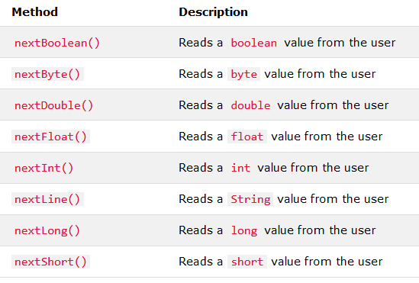
Accept input values through Scanner Methods
Java Scanner class provides the below methods to read (or accept) inputs of different primitives types:

Slide 5
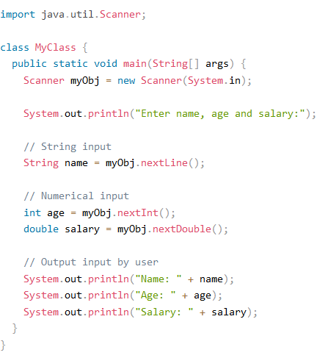
Example Program of accepting input values of different primitives

Slide 6
class
Def (class): A class is a blueprint that defines the variables and the methods common to all objects of a certain kind. When you create a class, you can use this type to declare objects of this type.
It is a basic concept of Object-Oriented Programming which revolve around the real-life entities (both conceptual and physical).
Class in Java determines how an object will behave (through methods) and what the object will contain (through variables’ data).
Any concept you wish to implement in a Java program must be encapsulated within
a class.

Slide 7
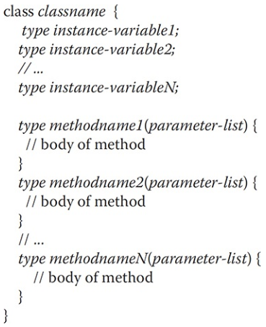
Syntax of Class in Java
Important Points
The data (or Variables) defined within a class are called as instance variables.
The code is contained within methods.
Collectively, the methods and variables defined within a class are called members of the class.

Slide 8
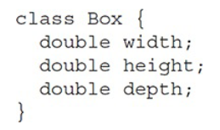
Example of a class

Slide 9
Objects
Def(Object): It is an instance of a Class. When a class is defined, no memory is allocated but when it is instantiated (i.e. an object is created) memory is allocated.
An Object consists of:
State : It is represented by variables (or attributes) of an object. It also reflects the properties of an object.
Behavior : It is represented by methods of an object. It also reflects the response of an object with other objects.
Identity : It gives a unique name to an object and enables one object to interact with other objects.

Slide 10
Instantiating Class (i.e., creating objects of class)
It is a two step process:
Declare a variable of the class type. This variable does not define an object. Instead, it is simply a variable that can refer to an object.
Acquire an actual, physical copy of the object and assign it to that variable. You can do this using the new operator. The new operator dynamically allocates (that is, allocates at run time) memory for an object and returns a reference to it.
Note: The reference is the address in memory of the object allocated by new. This reference is then stored in the variable.

Slide 11
Example of Instantiating Class (i.e., creating objects of class)
Box mybox = new Box();
The above statement creates an object, mybox of type Box.
or
The equivalent of the above statement can be provided using the below two lines:
Box mybox; // declare reference to object
mybox = new Box(); // allocate a Box object

Slide 12
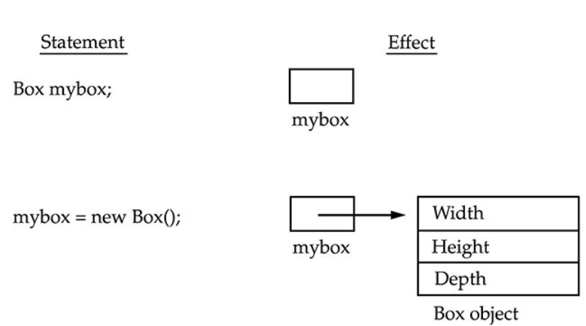
Effect of of Instantiating Class (i.e., creating objects of class)

Slide 13
Accessing members of a class
To access the variables and methods of a class, you will use the dot (.) operator. The . operator links the name of the object with the name of an instance variable.
Example of accessing variable:
mybox.width = 100;
The above statement assigns the width variable of mybox the value 100.

Slide 14
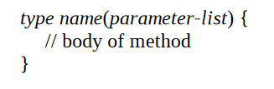
Methods of a class.
Def (Method): It is an action which an object is able to perform. We use methods to access the instance variables defined by the class
Syntax for defining method in Java:
Note:
- type specifies the type of data returned by a method. This can be any valid type, including class types that you create. If the method does not return a value, its return type must be void.
- The name of the method is specified byname.
-The parameter-list is a sequence of type andidentifier pairs separated by commas.

Slide 15
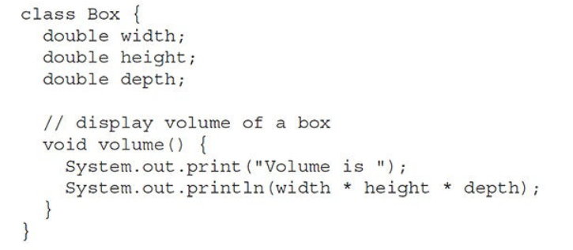
Example of adding a method to a class
The above class Box has a method called volume() to display the volume of the Box. It does not return any value.
Hence, its return type is void.

Slide 16
Accessing variables and method of a class through Object
Box mybox1=new Box(); // creating mybox1 object.
mybox1.width=12; // accessing and assigning value to width instance variable
mybox1.height=10; // accessing and assigning value to height instance variable.
mybox1.depth=11; // accessing and assigning value to accessing depth variable.
mybox1.volum();// access a method volume(), which displays the volume of the box.

Slide 17
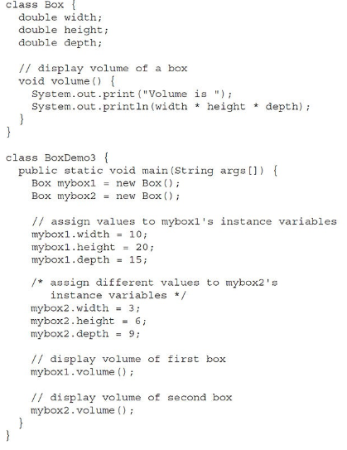

Slide 18
Constructors
Def(Constructor): A constructor initializes an object immediately upon creation. It has the same name as the class in which it resides and is syntactically similar to a method.
Constructors avoid tedious job of initializing all variables of class each time when an object is created.
Constructors in Java allows objects to initialize themselves when they are created.
This automatic initialization is performed through the use of a constructor.
The constructor is automatically called when the object is created, before the new operator completes.
Constructors look a little strange because they have no return type, not even void.

Slide 19
Types of Constructors
Default constructor: If you do not implement any constructor in your class, Java compiler inserts a default constructor into your code on your behalf. This constructor is known as default constructor.
No-argument constructor: Constructor with no arguments is known as no-arg constructor (without parameters).
Parameterized constructor: A constructor with parameters.

Slide 20
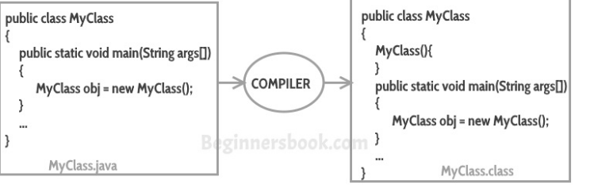
Example of Default Constructor
Note: If you implement any constructor then you no longer receive a default constructor
from Java compiler.

Slide 21
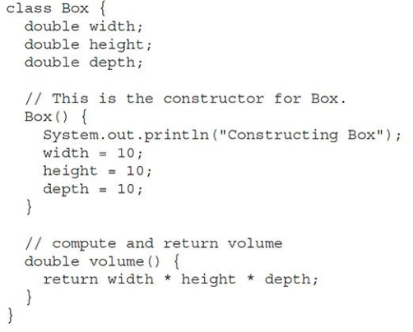
Example of No-arg Constructor
The class Box has a constructor
to initialize the dimensions (width,
height and depth) when an object
is created.
Note: In this type of constructor,
all objects will have same values
for those variables.

Slide 22
Initializing object through No-Arg constructor
Box mybox1=new Box(); // mybox1 object is instantiated.
Box mybox2=new Box(); // mybox2 object is instantiated.
The above statements initialize both objects mybox1 and mybox2 with respective instance variables width set to value 10, height set to value 10, and depth set to value 10.

Slide 23
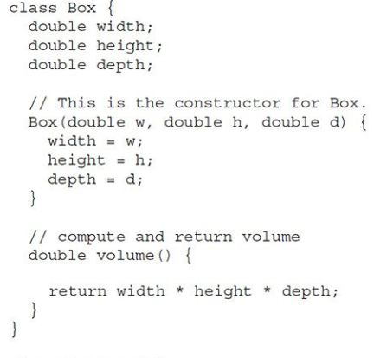
Example of Parameterized Constructor
The class Box has a constructor with
Parameters. It initializes the dimensions
(width, height and depth) when an object
is created.
Note: In this type of constructor,
all objects will have different values that are
passed at the time of object creation.

Slide 24
Initializing objects through Parameterized constructor
Box mybox1=new Box(10, 20, 30); // mybox1 object is instantiated.
The above statement initializes mybox1 object with instance variables width set to value 10, height set to value 20, and depth set to value 30.
Box mybox2=new Box(100, 200, 300); // mybox2 object is instantiated.
The above statement initializes mybox1 object with instance variables width set to value 100, height set to value 200, and depth set to value 300.

